Slide 1
Parents’ evening presentation

Slide 2
The Role of
UCAS
UCAS processes applications for full-time courses at higher education providers in the UK.
We guide students through the whole process providing valuable information and supporting services for applicants and their parents.

Slide 3
Why higher education?
Opportunities whilst studying
Chance to study a subject they are passionate about
Achieve a qualification that will lead to their chosen career
Gain confidence, independence and important life skills that will widen their prospects
Making lifelong friends

Slide 4
With a degree…
The opportunity to follow their career path
Better job prospects
Many employers target graduates
Higher earning potential

Slide 5
Researching courses
Your son or daughter can use the UCAS search tool
search.ucas.com

Slide 6
Other things to consider
Finance – course fees, grants, travel and living costs
Travel – to and from home
Accommodation – uni halls or private residences?
Extra curricular activities

Slide 7
Visit, visit, visit …

Slide 8
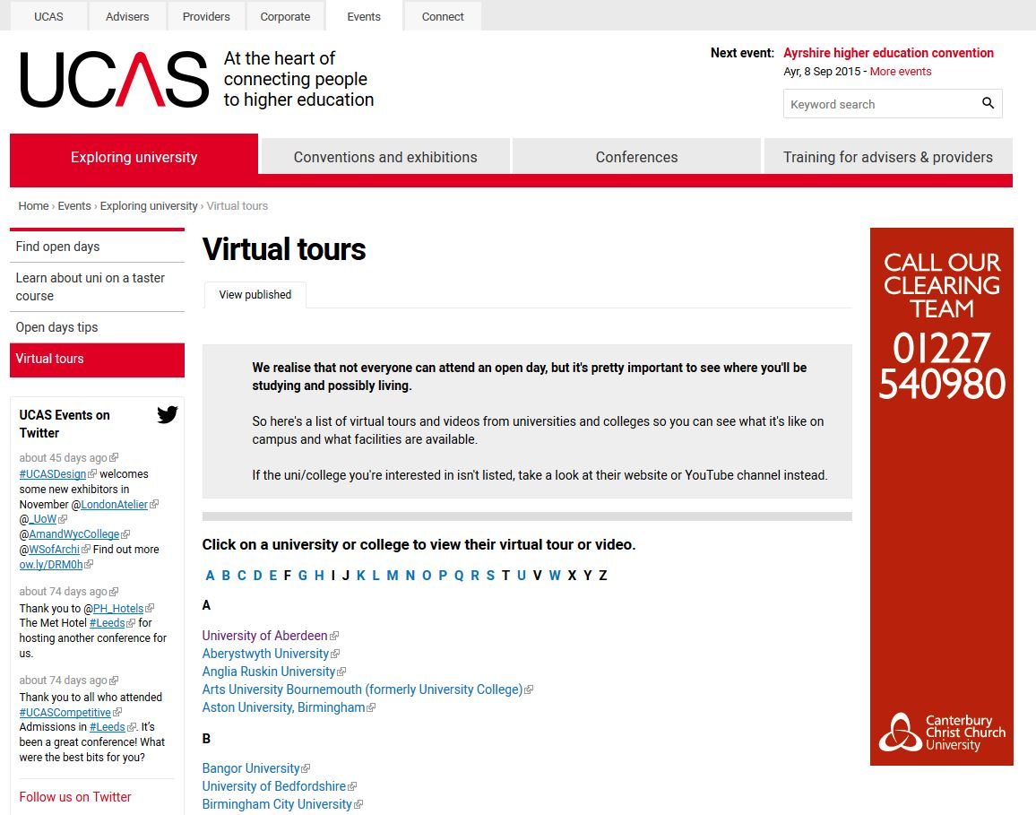
ucas.com/virtual tours

Slide 9
Key features of the UCAS undergraduate scheme
One application per admissions cycle
Application fee £23 / £13
Maximum five choices (some restrictions)
Nominated access option
Simultaneous consideration
Universities cannot see the other choices

Slide 10
When to apply
Mid September Applications can be submitted to UCAS
15 October Medicine, Veterinary and Dentistry Oxford or Cambridge
15 January Advisory application deadline
24 March Some art & design courses
(check each course)
30 June Applications held
for Clearing

Slide 11
Completing the application
Maximum of five choices
Some choice restrictions:
Medicine, Veterinary, Dentistry – max four
Oxford or Cambridge
Simple application cost:
1 choice - £12
2-5 choices - £23
Application is entirely online
Simultaneous consideration

Slide 12
The personal statement
The only section your son or daughter has control over
Their only chance to market themselves individually
One personal statement for all choices
Max. 4,000 characters, 47 lines
Min. 1,000 characters
No spelling/grammar check
No formatting

Slide 13
Where to start
Think about what makes them stand out in an exciting and positive way
Show enthusiasm for the course they are applying for and list supporting evidence to back this up.
Extra curricular activities and relevant work experience.
Skills they can use on the course, leadership, communication, team work for example.
Encourage them to ask you for more ideas.
Allow plenty of time.

Slide 14
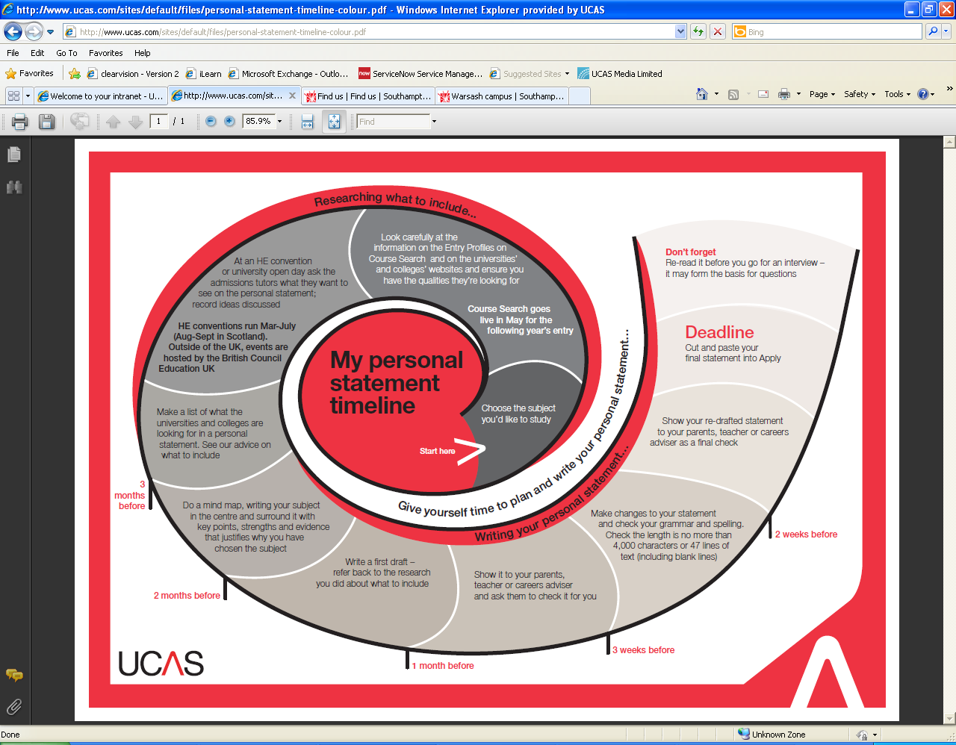
Personal statement
resources
www.ucas.com/personalstatement

Slide 15
Tracking applications
Track will allow your son or daughter to:
Follow the progress of their application online
See their choices and personal information
See their offers
Reply to offers online

Slide 16
Decisions and replies
Provider decisions:
Unsuccessful
Unconditional offer
Conditional offer qualifications and achievements and or UCAS Tariff points
FIRM = where you really want to go
INANCE =
Once all decisions are received, they can hold up to two offers:
One as their Firm Choice
One as their Insurance Choice (if they want to)
All other offers are declined
Track will show their reply date

Slide 17
Other options
Extra 24 Feb-4 July
If all five choices have been used and they have no offers/rejected all offers
Clearing from mid-July
If there are no offers, or have applied after 30 June deadline
Adjustment
(from A level results day)
If they’ve gained better results than the conditional offer they hold, they could apply for
a different course or university

Slide 18
What your son/daughter should be doing now?
Research
Extra Curricular
Work experience
Go beyond the syllabus
Focus on this year’s studies

Slide 19
How can you support the
application process?
Use the Parents/Guardian section of the UCAS website/Parent Guide publication – www.ucas.com/parents and sign up for the newsletter.
Offer to attend open days, you may have a different perspective.
Don’t book family holidays at key times.
Make sure they read everything carefully that is sent to them.
Support your son/daughter’s management of their application.

Slide 20
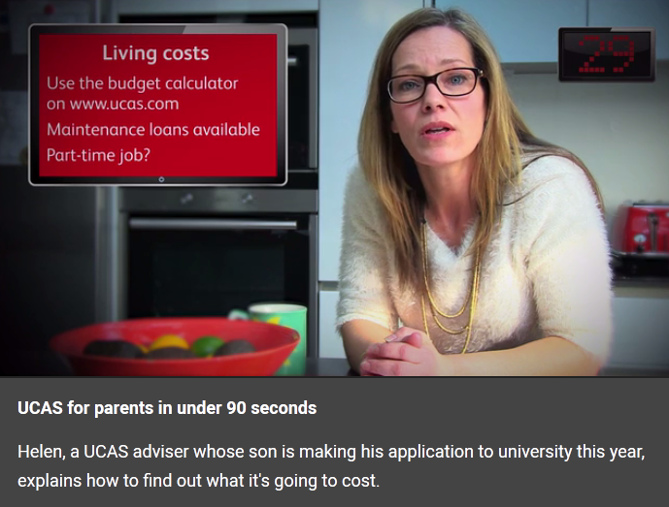
New videos for parents
UCAS has developed four videos on key topics:
The UCAS process
Open days
Student finance
Clearing
FIRM = where you really want to go
INSURANCE =
you would be happy to
get into
your FIRM choice
INSURANCE = somewhere
you would be happy to
get into
your FIRM choice
www.ucas.com/parents

Slide 21
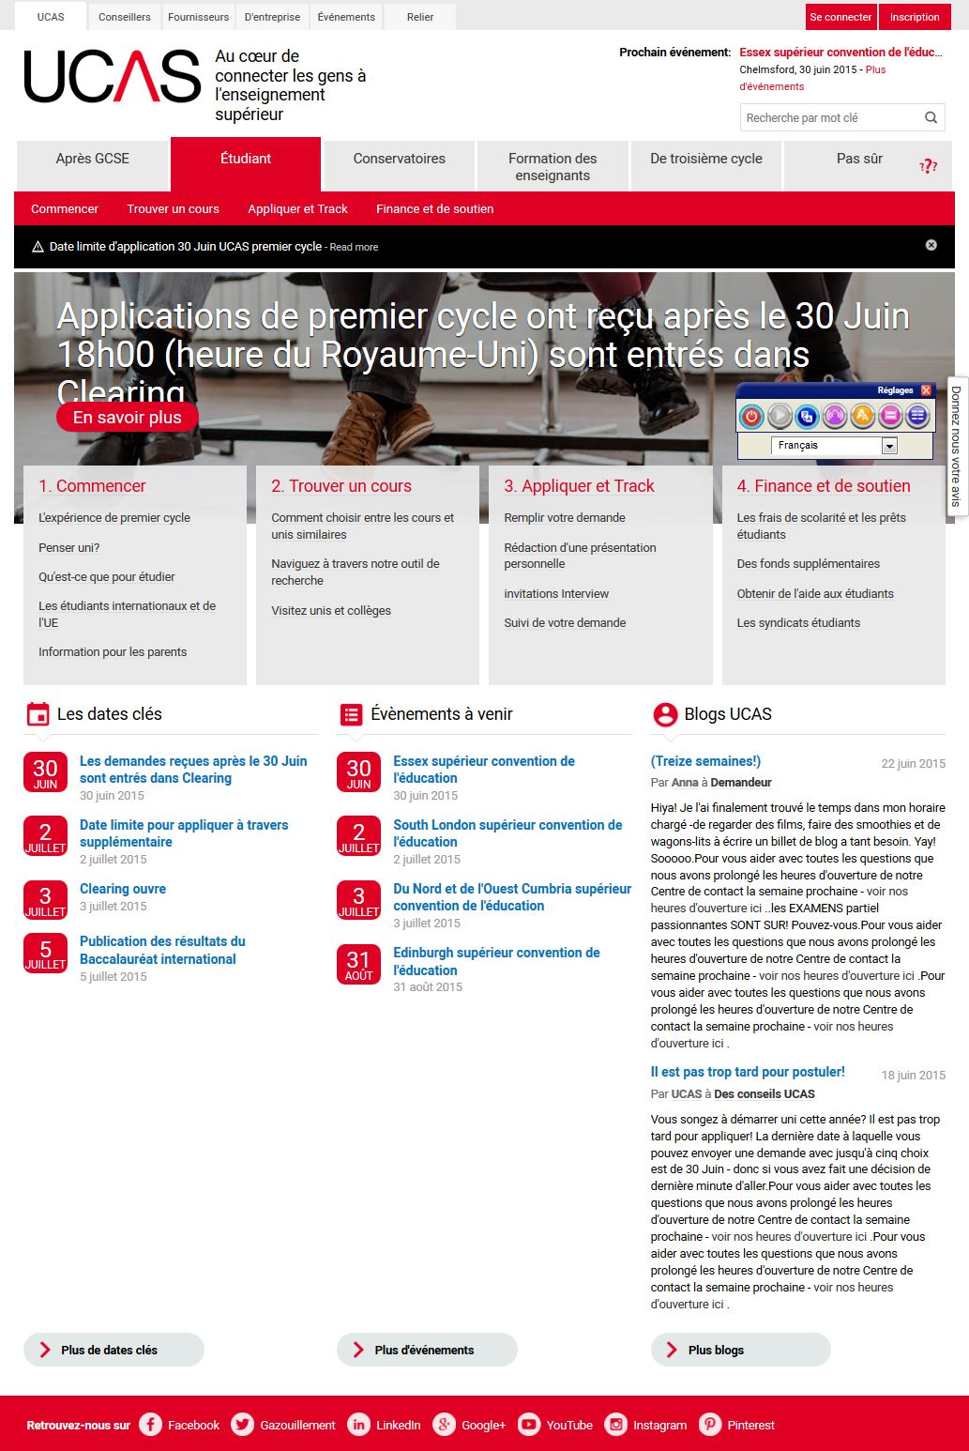
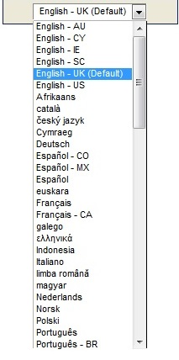
Translate ucas.com - BrowseAloud

Slide 22
ucas.com/connect

Slide 23
Additional help
UCAS Customer Experience Centre
0371 468 0468
Monday to Friday, 08:30 – 18:00 (UK time)

